Slide 1
Monetary Policy
Tug of war b/w Inflation and growth
April 13rd, 2017
BY:
SAURABH GOYAL
ANIL MAHIDAR REDDY

Slide 2

Contents
What is monetary policy ?
Why Monetary Policy?
Quantitative Tools
CRR
SLR
Repo Rate
Reverse Repo Rate
OMO
Impact of Tools
Notes:
http://www.businessnewsdaily.com/images/i/000/003/307/original/shutterstock_103289048.jpg?interpolation=lanczos-none&fit=inside%7C660:*

Slide 3
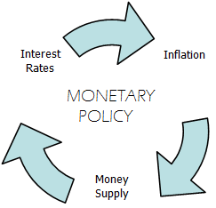
What is Monetary Policy?
process by which the monetary authority of a country, like the central bank or currency board, controls the supply of money, often targeting an inflation rate or interest rate to ensure price stability and general trust in the currency
Notes:
management of money supply and interest rate and is the demand side economic policy used by the government of a country to achieve macroeconomic objectives like inflation, consumption, growth and liquidity.

Slide 4

Money Supply
Money supply is the entire stock of currency and other liquid instruments
circulating in a country's economy as of a particular time.
Notes:
http://www.theequicom.com/blog/wp-content/uploads/2014/10/M_Id_469909_Money_bag.jpg
https://3.bp.blogspot.com/-AHUAMeRa6fo/WEEO-UcEBlI/AAAAAAAAAMA/lE1h7Bru-_YmX2lpVD2LFfCH_JbKB-DzwCLcB/s1600/rupees-symbol-png-26.png
monetary policy is to control the money supply in an economy but what is money supply....money supply is the total stock of currency in the form of cash and other liquid instruments as gold and silver that are circulating in an economy as of a particular time.

Slide 5
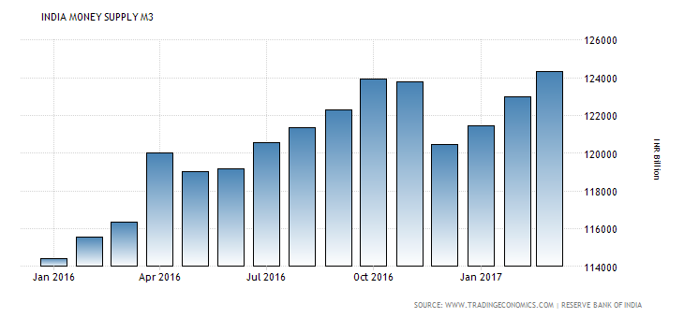
Notes:
http://cdn.tradingeconomics.com/charts/india-money-supply-m3.png?s=indiamonsupm3&v=201704031313t&d1=20160101&d2=20171231&type=column
there are Different measures of money supply as M0, M1, M2, M3 and M4. Not all of them are widely used and the exact classifications depend on the country. M0 and M1, also called narrow money, normally include coins and notes in circulation and other money equivalents that are easily convertible into cash. M2 includes M1 plus short-term time deposits in banks and 24-hour money market funds. M3 includes M2 plus longer-term time deposits and money market funds with more than 24-hour maturity. The exact definitions of the three measures depend on the country. M4 includes M3 plus other deposits. The term broad money is used to describe M2, M3 or M4, depending on the local practice.
money supply is continuously increasing from jan ,2016 to oct ,2016.because present RBI governer URJIT PATEL decreases the interest rate so there was more money supply in the market .But in oct due to demonetization there was a sudden restriction on the money supply inthe market and after liberalizing the withdrawal limit there was again a push in the money supply.

Slide 6
Why Monetary Policy?
“To attain a set of objectives oriented towards the economic growth and stability.
Neutrality of Money
Objectives
of
Monetary Policy
Full Employment
Exchange Rate Stability
Price Stabilisation
Economic Growth
Notes:
Monetary policy is how central banks manage liquidity to create economic growth. Liquidity is how much there is in the money supply. That includes credit, cash, checks and money market mutual funds. The most important of these is credit. It includes loans, bonds and mortgages.
Neutrality of Money
Exchange Rate Stability
In a fixed exchange-rate system, a country's central bank typically uses an open market mechanism that is a tool of moneatry policy to maintain its pegged ratio and, hence, the stable value of its currency in relation to the reference to which it is pegged.
A fixed exchange rate, sometimes called a pegged exchange rate, is a type of exchange rate regime where a currency's value is fixed against either the value of another single currency, to a basket of other currencies, or to another measure of value, such as gold.
Economic Growth
Price Stabilisation
Full Employment

Slide 7
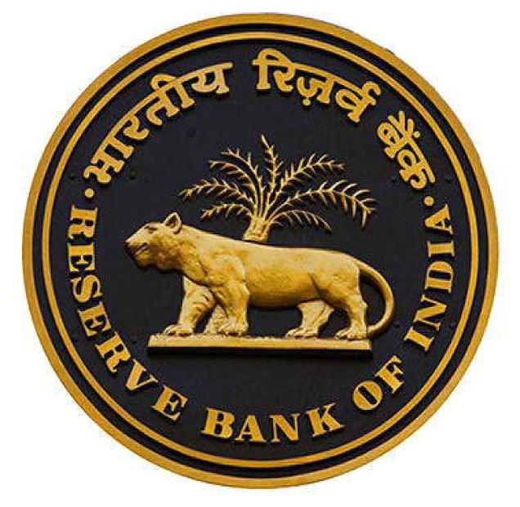
Features of Monetary Policy
Active Policy
Controlled Money Supply
Seasoned Variations
Flexibility
Investment & Saving Oriented
Notes:
Active policy:-
Controlled money supply:-
Seasonal variations:-
Flexibility:-
Investment & saving oriented:-
passive policy ....it means a predetermined set of rules that will not alter in response to the changing economic factors. example is of is pegging that is used to stablize our value of currency with respect to the another currency but it can lead to a take away from thar potential we can get if we go in a change with the situations.
active policy provide that opportunity to montary policies.
controlled money supply is to control the inflation and money supply for a proper economic growth.
seasoned variations means same as active policies as we are changing our policies acording to the situations. Flexibility also define that and investement and saving means whenever central bank want to save money more to reduce the money supply policies will be contractionary otherwise expansionary.

Slide 8



Monetary policy Types
Expansionary
Money supply increases in an economy than usual.
Contractionary
Money supply decreases in an economy than usual.
Notes:
EXPANSIVE APPROACH
Monetary Supply
Investment Expenditure
Aggregate Demand
Price Level
TIGHT APPROACH
Interest Rates
CRR Increase
Repo Rate
Bank Rate
http://www.multiforex.org/wp-content/uploads/2017/02/lose-money.png

Slide 9


INFLATION
Inflation is a sustained increase in the general price level of goods and services in an economy over a period of time resulting in a loss of value of currency.
Notes:
https://images-na.ssl-images-amazon.com/images/I/417012vNfpL.jpg
https://img.clipartfest.com/8246a47bba9dc5bbb633a38cf0680213_coins-stack-png-clipart-clipart-coins-transparent-background_2080-2560.png
money policy is to control the money supply and to control the inflation but what is inflation and how it is fatal for an economy.
So Inflation is a general increase in the price of basket of goods over a period of time . “basket of goods ”so inflation is not defined for an individual good. It is fatal for economic growth as if there is too much money supply in the economy then demands will increase for goods so prices will go higher and the value of money will go down. BUT a less and sustained inflation is necessary for economic growth because it will assure an controlled sufficient money supply in the market increasing employment and GDP.

Slide 10

Tug Of War
b/w
Growth And Inflation
Notes:
https://pixabay.com/en/gleise-old-railroad-tracks-seemed-1555348/

Slide 11


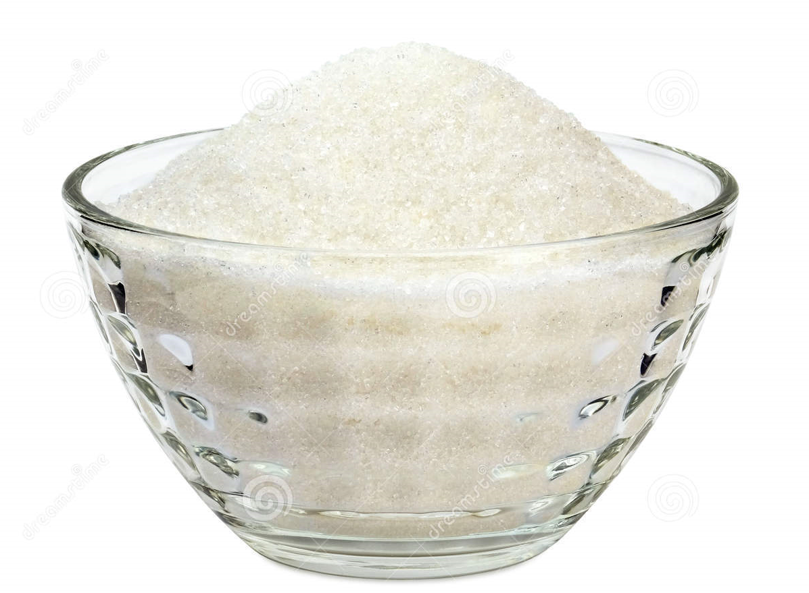

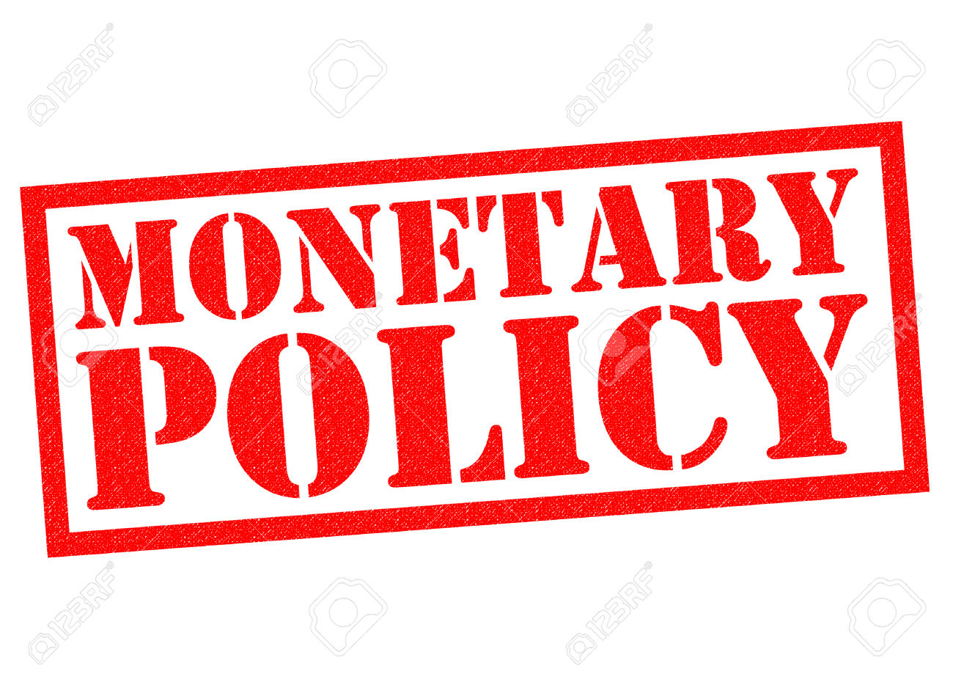

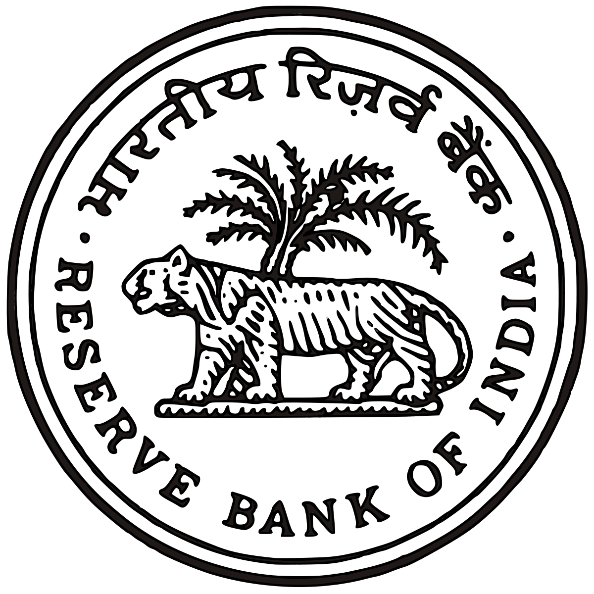
“ Too less sugar means a bitter coffee, and too much sugar has health consequences. Both types have their patrons.
Reserve Bank of India (RBI) likes its coffee bitter.
Central government likes it too sweet. The twist is that there is a recipe sufficient only for one cup! ”
Inflation
control
Economic
growth
Notes:
https://img.clipartfest.com/af08b24be95103150168907d04e9eee5_coffee-coffee-cup-clipart-transparent-background_958-1029.png
https://apps.mgov.gov.in/displayimage.do?784
Means central bank wants to control the inflation first but for the central govt. economic growth is the first priority but if we will focus too much on the economic growth then govt has to decrese the interest rates that will cause more money supply in the market and can cause inflation .but if we will focus to control the inflation then interests rates will be high and there will be less money supply in the market that can cause the unemployment and decrease in GDP.

Slide 12
Quantitative Tools

Slide 13
Quantitative Tools
CRR
SLR
Repo Rate
Reverse Repo
OMO
Cash Reserve Ratio
Statutory Liquid Ratio
Repossession Rate
Reverse Repossession Rate
Open Market Operation

Slide 14

Cash Reserve Ratio : It’s Impact
Central Bank
A part of
total deposit
Commercial /Domestic Bank
Loans & Advances
Consumer / Customers
Proposition of total deposit which the commercial bank has to keep with central bank of that country in liquid form. (current ratio : 4%)
* Less money circulation
* Higher interest rates
* Can cause unemployment
* More Money Circulation
* Lower Interest Rates
* Employment
BUT can lead to Inflation.

Slide 15


Statutory Liquid Ratio : It’s Impact
Central Bank
Commercial /Domestic Bank
Loans & Advances
Consumer / Customers
Proposition of total deposit which the commercial banks have to keep with themselves in liquid form. (current ratio: 20.50% )
* Less money circulation
* Higher interest rates
* Can cause unemployment
* More Money Circulation
* Lower Interest Rates
* Employment
BUT can lead to Inflation.
Notes:
https://img.clipartfest.com/e3761c38676dfce37e7c8a29e5ce5bb2_money-bag-clipart-money-bag-clipart-transparent-background_444-598.png
in crr banks have to keep money with central bank but in slr they have to keep it with themselves.
if slr is high then there will be less money with the banks to circulate in the market
if slr is decresed in order to circulate more money in the market but if it is not inn controlled manner then it can lead to infaltion.

Slide 16
Repo Rate : It’s Impact
Central Bank
Loans & Advances
Commercial /Domestic Bank
Loans & Advances
Consumer / Customers
Repo Rate is the Rate at Which the Commercial Banks borrows from the Central Bank(RBI in India). (current rate: 6.25%)
* Less money supply
* supply exceed demand
* inflation control
* More Money supply
* Demand will increase
* could lead to growth
BUT can lead to Inflation.
( SHORT PERIOD )

Slide 17
Bank Rate : It’s Impact
Central Bank
Loans & Advances
Commercial /Domestic Bank
Loans & Advances
Consumer / Customers
When banks borrow long term funds from RBI. They’ve to pay this much interest rate to RBI. (current rate: 6.50%)
* Decrease Money Supply in Economy
* Inflation Control
* Economic Growth Suffers
( LONG PERIOD )
* Increase in Money Supply
* Economic Growth Targeted
* Inflation Control Suffers

Slide 18
Reverse Repo Rate : It’s Impact
Central Bank
Loans & Advances
Commercial /Domestic Bank
Loans & Advances
Consumer / Customers
Reverse Repo Rate is the Rate at Which the Central Bank(RBI in India) borrows from the Commercial Banks. (current rate: 6%)
* Decrease of credit in market
* Inflation Control Targeted
* Can cause deflation
* increase of credit in Market
* Economic Growth Targeted
* can cause inflation
Notes:
why central bank will borrow money from commercial banks as it prints the cash so it will never be in shortage of money. the asnwer is sometimes in certain situations banks have too much money to supply so to control that central banks offers commercial banks to lend money at higher interest rates . so for more profit commercial banks will lend to the central bank and money supply can be controlled.
And sometimes when commercial banks borrow from central bank at repo rate then it offers them the money without maintaning crr and slr on that money with an agreement that they have to lend money to the central bank at a particular interest rate.
Example is as

Slide 19
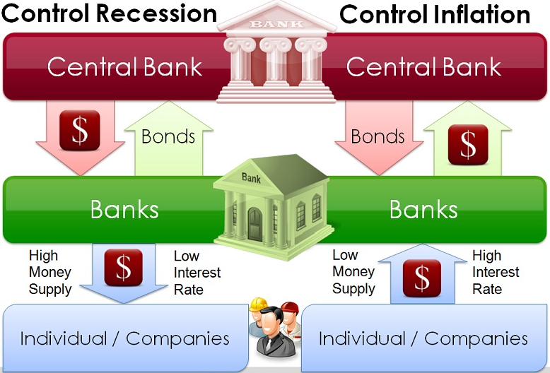
Open Market Operation
Notes:
A government bond is a bond issued by a national government, generally with a promise to pay periodic interest payments and to repay the face value on the maturity date. Government bonds are usually denominated in the country's own currency.

Slide 20
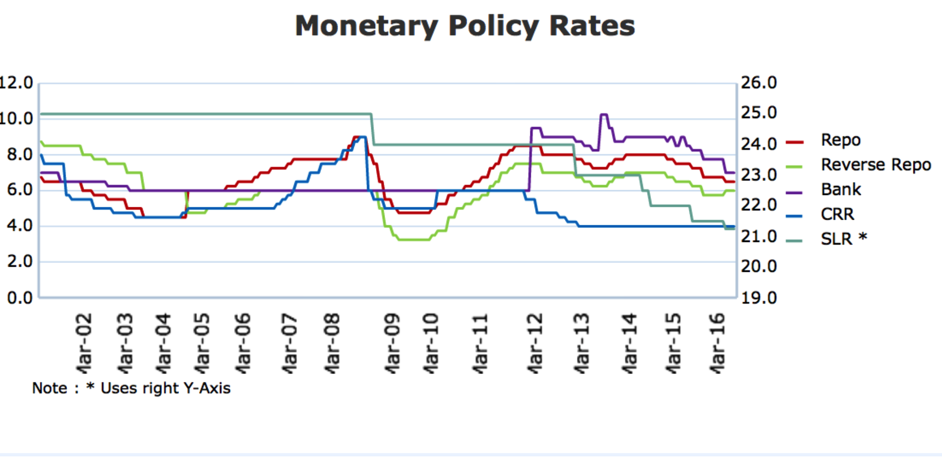
@source: rbi.gov.in

Slide 21
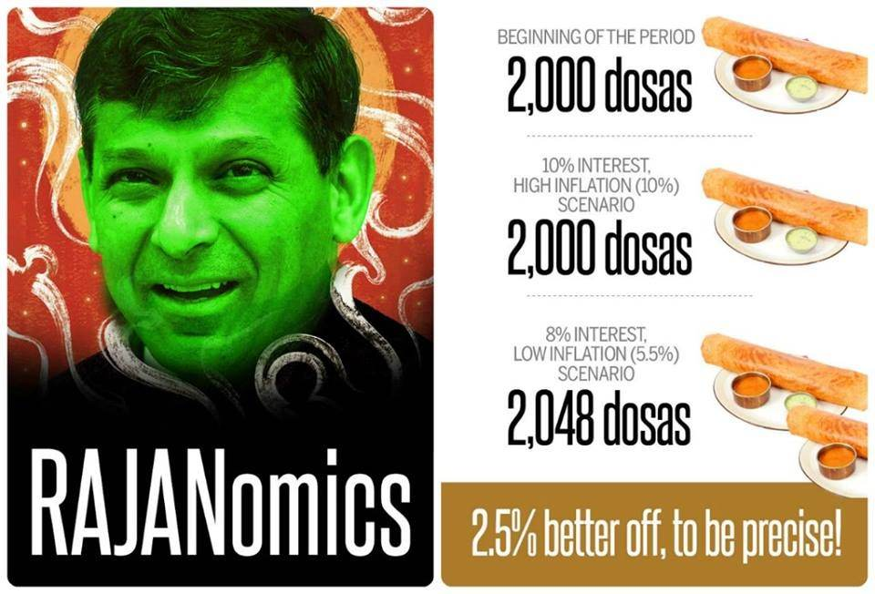
Monetary policy of Raghuram Rajan
Rajan is known for his primary focus on curbing inflation.
Under Rajan, the RBI adopted consumer price index (CPI) as the key indicator of inflation
India’s Forex Reserve is now stronger by about 30% than it was two years back.
GDP growth in the first quarter of 2014-15 is 5.7% against 4.7% in the comparable period last fiscal year
Communication:
A central bank should never say “Never”! But the public should have a clear framework as to where we are going, and understand how our policy actions fit into that framework.
Bold decisions:
When there is policy review, almost all the business channels have a poll of the possible outcomes of the policy review.
@source :https://www.rbi.org.in
Notes:
A consumer price index (CPI) measures changes in the price level of market basket of consumer goods and services purchased by households. The CPI is a statistical estimate constructed using the prices of a sample of representative items whose prices are collected periodically.
The Reserve Bank of India (RBI), in its third monetary policy review of the year, left repo rates unchanged at 6.50 percent at a five-year low adopting an accommodative stance on the monetary policy.
Inflation : Rajan said going forward the RBI will have to see how the monsoon plays out and how it affects food prices. RBI maintained FY17 consumer price index target.
Liquidity : Rajan said he cannot commit to a time frame to move to liquidity deficit neutral situation.
Growth Target : Rajan maintained the gross value added (GVA) growth projection for 2016-17 at 7.6 per cent with risks evenly balanced.
Further Cuts : Rajan said the RBI will monitor macroeconomic and financial developments for any further scope for policy action in its third bi-monthly monetary policy statement, which will be announced on August 9, 2016.
Global Uncertainty : Rajan said Brexit as a source of volatility cannot be ruled out and could potentially cause some financial turmoil, but India should be able to weather any kind of volatility.
NPAs: Rajan said the RBI was working with the govt and SEBI on cleaning banks' balance sheets.
FCNRs : Rajan said he does not see leveraged portion of FCNR(B) deposits renewed. He said the RBI is committed to providing short-term rupee liquidity, and may sell dollars in extreme volatility situation "but that cannot be taken for granted."
Reappointment : Rajan said he will not be able to say more than to point to the statement made by the Prime Minister and the Finance Minister on the subject "It would be cruel of me to spoil the fun the press is having with my appointment," Rajan said.
Payment Banks : Rajan said licensing has been adequately liberal and it was not overly perturbed that some payment bank licensees have decided to back out after analysis.

Slide 22
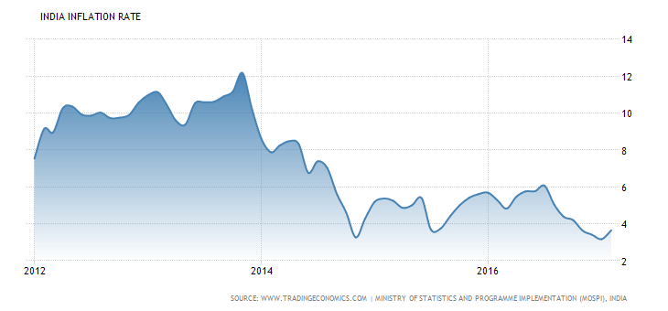
Notes:
http://cdn.tradingeconomics.com/charts/india-inflation-cpi.png?s=incpiiny&v=201704031313t&d1=19170101&d2=20171231&type=splinearea

Slide 23
CRITICAL EVALUATION

Slide 24
Analysis Of Monetary Policy 2017
RBI has shifted from accommodative stance towards neutral stance.
HOW RBI IS PLAYING?
The momentum will pick up because the withdrawal limits have been liberalised.
So there will be more money coming into the market.
That is a positive side and that was needed because due to demonetisation created a very restricted money supply situation in the market.(better condition for small scale industry)
WHY IT IS BEING CAUTIOUS?
Certain pockets of industry were expecting that the rate of interest would be lowered and more borrowings in the market would be available.(i.e 25 BPS cut was expected but the RBI has taken a cautious approach)
This can be linked to global situation because there is a lot of uncertainty out there like US Fed Reserve's and oil crisis.
We are living in a highly integrated world where the national boundaries are very fluid. The policies of superpower and developed country do impact our policy also
Agriculture (subsidies but what about other sectors), power plants etc works on oil.
The rise in oil price will jack up production cost which will have impact on inflation.
Notes:
RBI has liberalised withdrawal limits in order to overcome the situation of restricted money supply due to demonetisation.
And have not changed the interest rates because of the uncertainity due to TRUMP effebst and world oil crisis so there were a confusion what to do so RBI decides not to change them.

Slide 25
Analysis Of Monetary Policy 2017(contd.)
BALANCE MAINTAINED
So to keep a balance RBI has increased the withdrawal limit to supply more money in the market.
They have liberalised it because the small scale industries were feeling the adverse impact of demonetisation.
This will help pick up growth.
On the other side RBI has to keep inflation under control apart from increase in growth rate.
If you are not reducing the repo rate then you are also controlling inflation. (Demand and Supply)
In December, RBI has projected the headline inflation at 5% in 4th quarter of 2016-17.
In the first half of the next financial year the RBI projects the inflation to be in the range of 4% to 4.5% and 4.5% to 5% in 2nd half of the financial year 18. If you are not reducing the repo rate then you are also controlling inflation.
GROWTH PROJECTION
RBI projected GDP growth at 6.9% this financial year.
Demonetisation did have an impact on GDP.
Budget and Economic Survey has accepted that it is due to demonetisation that growth of small scale industry and service sector to some extend has been impacted by it because they were dependent on cash.
Demonetisation has played a role of a speed braker.
Notes:
And this liberalisation of money is beneficial for small scale industries that will lead to the economic growth but it can also be a reason of inflation so to control that RBI decides not to reduce the repo rate means now banks will have low money to circulate.

Slide 26

DHANYABAD SA

